Slide 1
Popularity Prediction and Recommendation of Spotify Songs
Names: Qin JINTAO & LUO TIANZI
Group number: 7
Notes:
Hello everyone, here is the group 7. our topic is popularity prediction and reconmmendation. My name is Luo tianzi and Qin jingtao is my partner.

Slide 2
Introduction/background
Music has always been an integral part of our lifes. Different people have different musical tastes. Some people’s musical tastes are quite different from what is popular in the mainstream. So, we fascinated by why certain songs are popular.
We also want to design a recommendation system which can recommend songs for us according to our play counts, popularity and other features.
Notes:
Why we want to do this topic is

Slide 3
Problem formulation
1.Data mining
(a) correlation between these features
(b) select the top k best features
2.target Encoding of Artists
(a) The Target Encoding approach
(b) Check number of occurrences
(c) Find cutoff points

Slide 4
Problem formulation
3. Data Normalizing
(a) normalize the numerical range of features
4. Popularity prediction and cluster based Recommendation
(a) Models used for prediction
Linear Regression
K-Neighbors Regression
Decision-Tree Regression
Random-Forest Regression
Multi-layer Perception (MLP) Regression
(b) introduction of recommendation algorithm
Notes:
Our data downloaded from Kaggle.

Slide 5
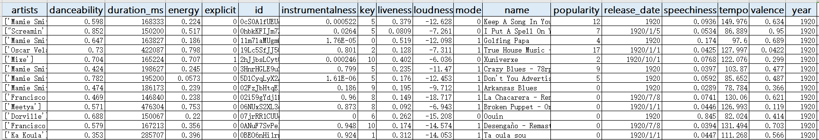
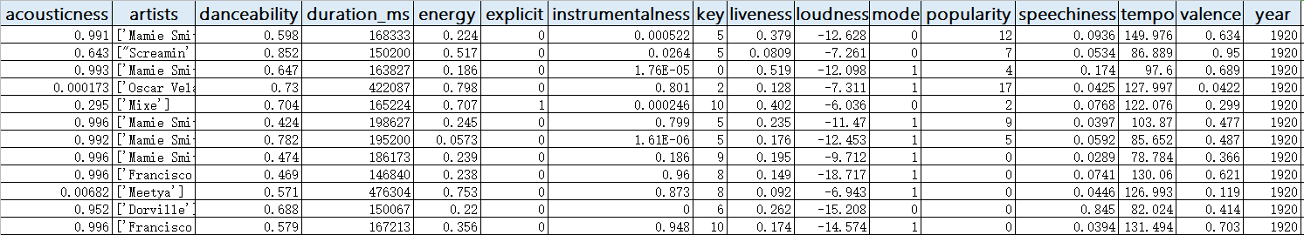
Problem formulation
1a. correlation between these features
Original dataset from Kaggle
Dropped the 'id', 'name' and 'release-date'
Notes:
We plotted the heatmap of the features and find the fond the most linear correlated features to popularity are:

Slide 6
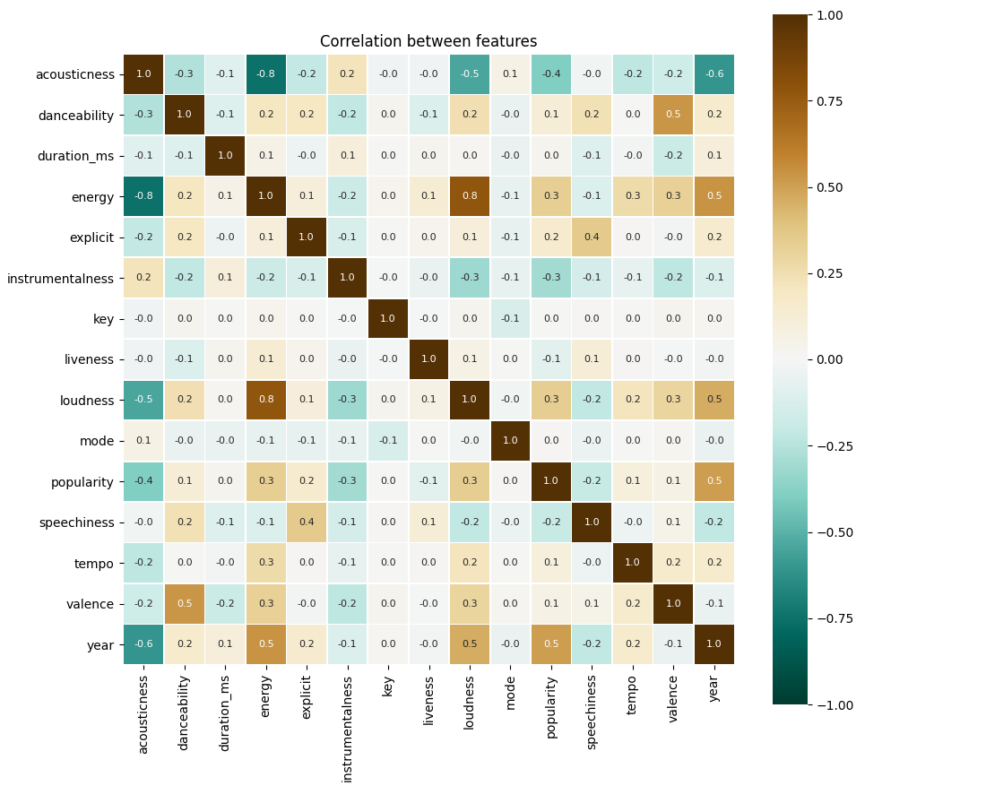
Problem formulation
1a. correlation between these features
The most linear correlated features to popularity:
year (0.5 abs),
acousticness (0.4 abs),
energy (0.3 abs),
loudness (0.3 abs),
instrumentalness (0.3 abs),
speechiness (0.2 abs)
explicit (0.2 abs).
Fig1. Heatmap of the features
Notes:
We plotted the heatmap of the features and find the fond the most linear correlated features to popularity are:

Slide 7
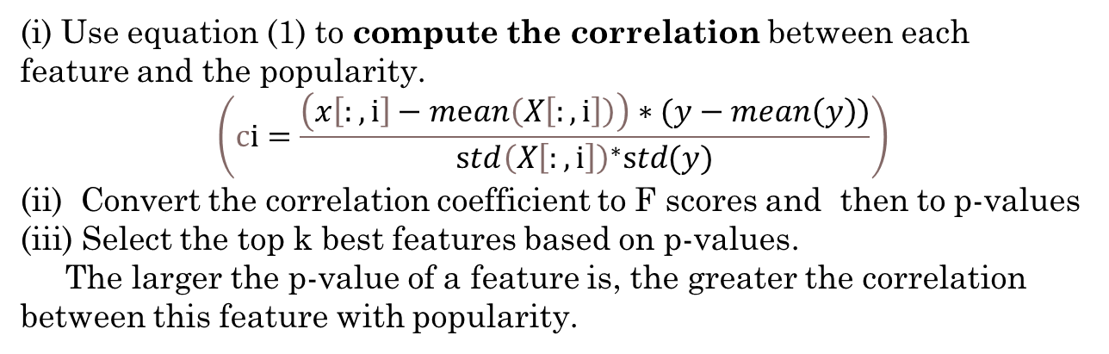
Problem formulation
1b. select the top k best features
Use ’f_regression’ method from sklearn
(i) Use equation (1) to compute the correlation between each feature and the popularity.
$$\left(cⅈ=\frac{\left(x\left[:,ⅈ\right]−mⅇan\left(X\left[:,ⅈ\right]\right)\right)∗(y−mean\left(y\right))}{std{\left(X\left[:,ⅈ\right]\right)}^{∗}std(y)}\right)$$
(ii) Convert the correlation coefficient to F scores and then to p-values
(iii) Select the top k best features based on p-values.
The larger the p-value of a feature is, the greater the correlation between this feature with popularity.
Notes:
The second step is use ‘f_regression’ to select the K best features. The equation is: ci is the correlation coefficient between feature i and popularity. X is the features matrix. Y is the popularity matrix.

Slide 8

Problem formulation
2a. The Target Encoding approach
Use Target Encoding approach and replace the artist with its mean popularity
$${\hat{x}}_{k}^{i}=\frac{δΣ_{j=1}^{n}{δ(x}_{j}^{i}=x_{k}^{i})·y_{j}^{i}}{δΣ_{j=1}^{n}δ\left(x_{j}^{i}=x_{k}^{i}\right)},k=1,…,m$$
Change the object type
string feature numerical feature
Notes:
It is obvious that 'artists' has strong correlation with a song's popularity. Since the 'artist' feature is Object type, we use the Target Encoding approach and replace the artist with its mean popularity.
Where n is the number of songs, m is the number of artists,ˆxik is the encoding value of the k-th song corresponding to the i-th artist, xij is the j-th song’s object value corresponding to the i-th artist, yij is the popularity of the j-th song corresponding to the i-th artist.
其中n是歌曲的数量，m是艺术家的数量，ˆxik是第i个艺术家对应的第k首歌曲的编码值，xij是第i个艺术家对应的第j首歌曲的对象值，yij是第i个艺术家对应的第j首歌曲的流行度t

Slide 9
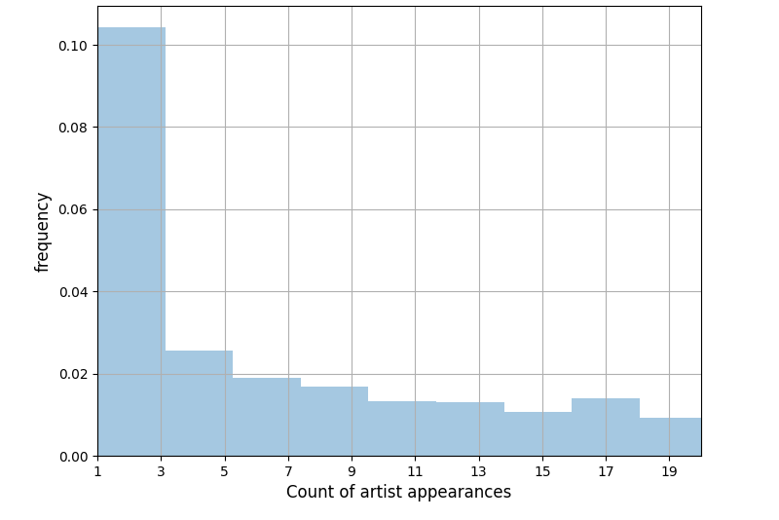
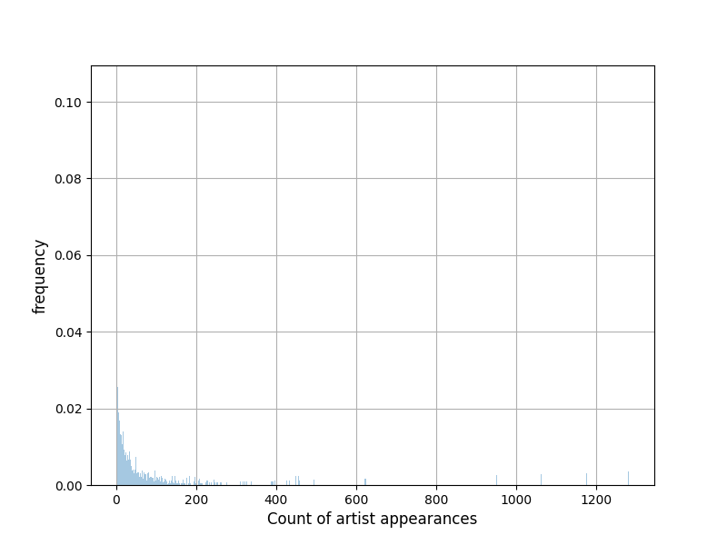
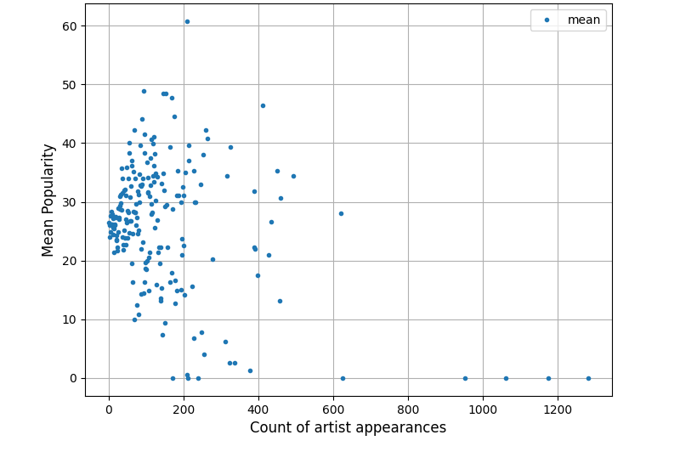
Problem formulation
2b. Check number of occurrences
2c. Find cutoff points
check number of occurrences that the artists appear in the data
Cutoff point:3
Cutoff point:600
Notes:
Then we check the number of occurrences that artists appear in the data.
Figure on the left hand side shows the frequency of count of artists' appearances.
If we zoom in to the left area and find out that most of artists appear less than 3 times
We also check for correlation between the number of appearances in data and the mean of popularity and we found if the artist appears more than 600 times, the popularity will be almost 0.

Slide 10
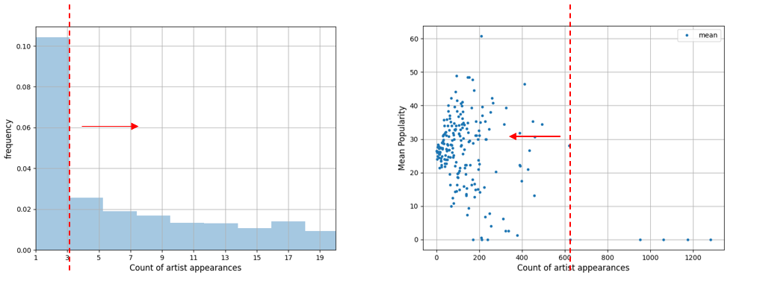
Problem formulation
(i) 3 is the first cutoff point. Replace the encoding value of the artists who appears less than 3 times with mean popularity of all songs.
(ii) 600 is the second cutoff point. Replace the encoding value of the artists who appears more than 600 times with zero.
(iii) Replace the encoding value of the artists who appearance time between 3 to 600 with the mean popularity (the average of a singer's songs).

Slide 11

Problem formulation
3a. normalize the numerical range of features
The numerical range of features are quite different, which may leads to a bad performance of our regression model.
$$x^{∗}=\frac{x−\min\left(x\right)}{\max\left(x\right)−\min\left(x\right)}$$
Notes:
It is obvious that 'artists' has strong correlation with a song's popularity. Since the 'artist' feature is Object type, we use the Target Encoding approach and replace the artist with its mean popularity.
Where n is the number of songs, m is the number of artists,ˆxik is the encoding value of the k-th song corresponding to the i-th artist, xij is the j-th song’s object value corresponding to the i-th artist, yij is the popularity of the j-th song corresponding to the i-th artist.
其中n是歌曲的数量，m是艺术家的数量，ˆxik是第i个艺术家对应的第k首歌曲的编码值，xij是第i个艺术家对应的第j首歌曲的对象值，yij是第i个艺术家对应的第j首歌曲的流行度t

Slide 12

Problem formulation
4a. Models used for prediction
Linear regression
Linear Regression fits a linear model with coefficients to minimize the residual sum of squares between the observed targets in the dataset, and the targets predicted by the linear approximation.
$$\min_{w}{\left\|X_{w}−y\right\|}^{2}$$
K-Neighbors Regression
The label assigned to a query point is computed based on the mean of the labels of its nearest neighbors.
Notes:
We use the following models to do the regression and compare their performance to select a best model

Slide 13
Problem formulation
Decision-Tree Regression
A tree can be seen as a piecewise constant approximation. The deeper the tree, the more complex the decision rules and the fitter the model.
In sklearn, we can use some hyperparameters to improve the generalization ability of decision tree like: ‘max_leaf_nodes’, ’max_depth’.
Random-Forest Regression
Individual decision trees typically exhibit high variance and tend to overfit. The injected randomness in forests yield decision trees with somewhat decoupled prediction errors.
Notes:
A model contains several decision trees and each of them built by some samples and attributes.

Slide 14
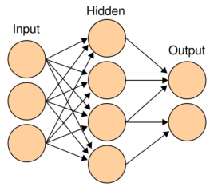

Problem formulation
Multi-layer Perception (MLP) Regression
MLP is a feedforward artificial neural network model, which maps multiple input data sets to a single output data set.
$$R^{m}→R^{o}$$
m is the number of dimensions for input
o is the number of dimensions for output.

Slide 15
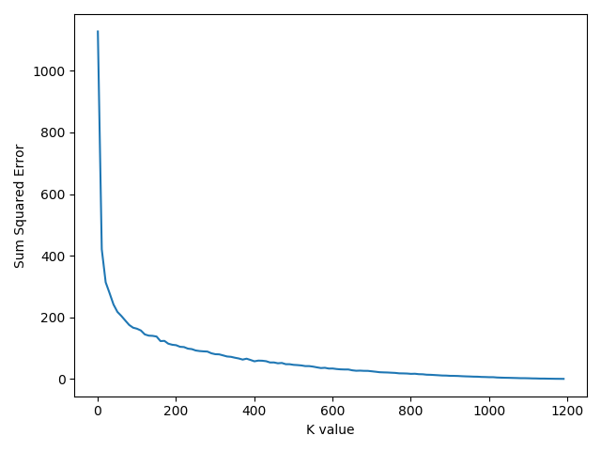
Problem formulation
4b. introduction of recommendation algorithm
(i) create N users and their play count of each song randomly.
(ii) Use K-means model to divide songs into different clusters based on the songs' correlation.
(iii) Find best-performance K = 1000
The smaller the SSE is, the better the performance is.
Notes:
Calculate the sum squared error (SSE) under different K

Slide 16
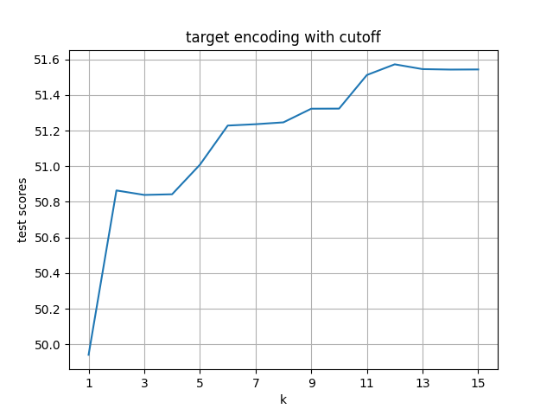
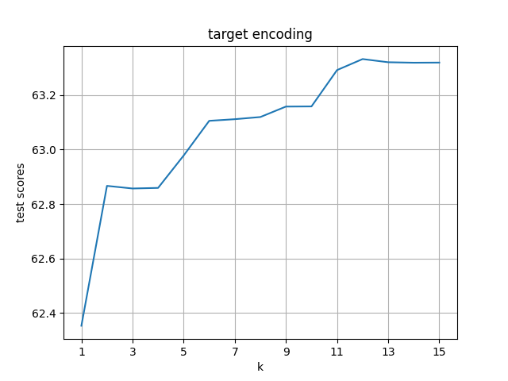
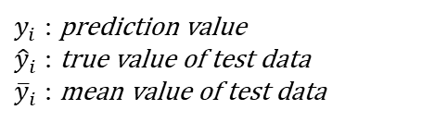

Experiments and results
1. Popularity Prediction
$y_{i}$ : prediction value
${\hat{y}}_{i}$ : true value of test data
${\overline{y}}_{i}$ : mean value of test data
$$R^{2}=1−\frac{Σ{\left(y_{i}−{\hat{y}}_{i}\right)}^{2}}{Σ{\left(y_{i}−{\overline{y}}_{i}\right)}^{2}}$$
measure the performance:
①Linear regression model
k=12
In the linear regression model, target encoding without cutoff works better.
Notes:
on the right left hand, the figure shows the result of target encoding with cutoff. but the best performance is lower than using target encoding without cutoff

Slide 17
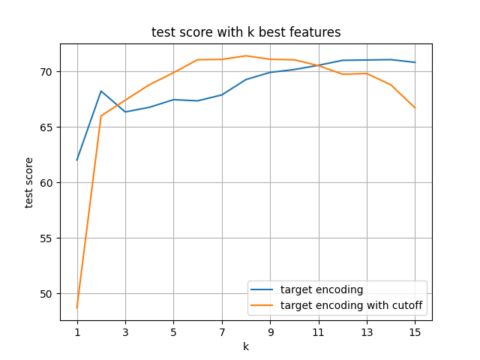
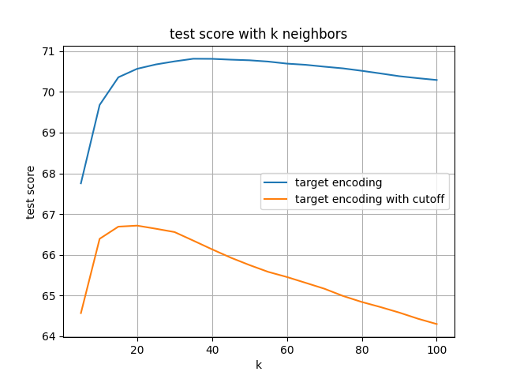
Experiments and results
1. Popularity Prediction
②K-Neighbors Regression
K=35
k=14
k=8
K=20
①Find the most suitable number of neighbors
② Find the k best features
Notes:
on the right left hand, the figure shows the result of target encoding with cutoff. but the best performance is lower than using target encoding without cutoff

Slide 18
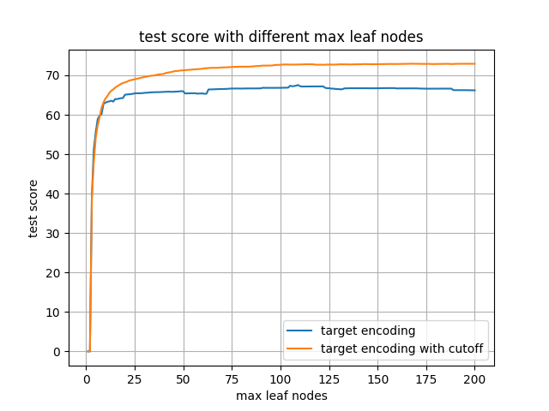
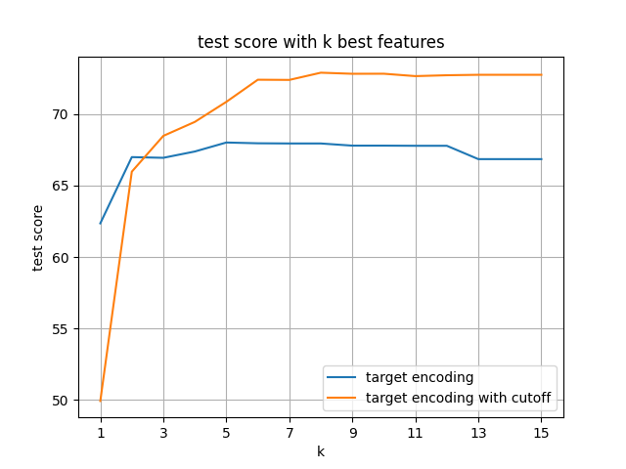
Experiments and results
1. Popularity Prediction
③Decision-Tree Regression
it is critical to determine the best value of max leaf node
k>7
① the model converges when ‘max leaf node’ is around 100.
② when k>7, the performances become stable .
Target encoding with cutoff works better.
Notes:
For decision-tree regression model, if the number of max leaf node is too small, the model will fail to capture relevant patterns, again lead to less accurate predictions. if number of max leaf node if too large, the model will capture spurious patterns that won’t recur in the future and lead to less accurate predictions.
The left hand side figure shows the test score under different max leaf nodes. We can see that the model converges when max leaf node is around 100. And for this model, it is better to use target encoding with cutoff.

Slide 19
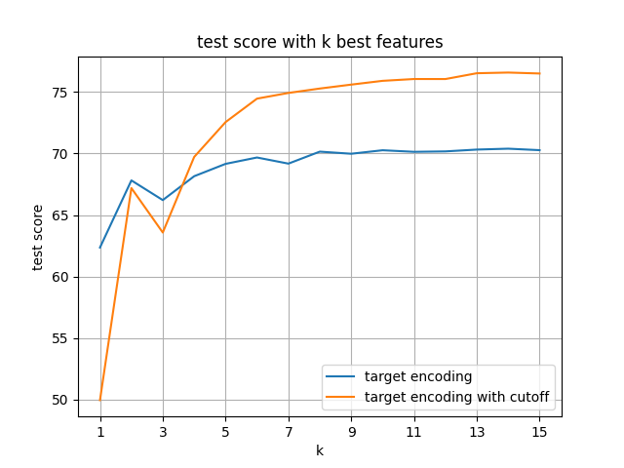
Experiments and results
1. Popularity Prediction
④Random-Forest Regression
Target encoding with cutoff works better. The best test score is over 75.

Slide 20
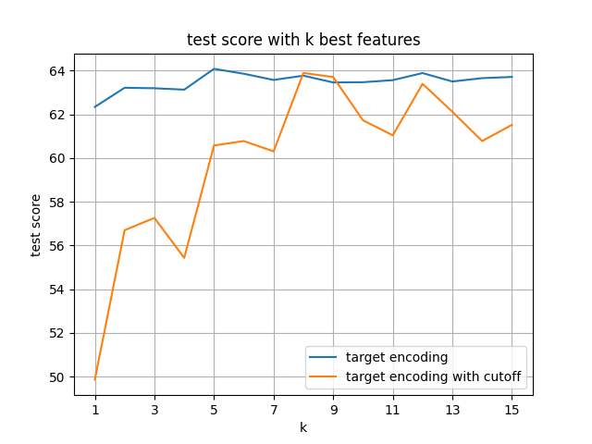
Experiments and results
1. Popularity Prediction
⑤Multi-layer Perception (MLP) Regression
5 hidden layer perception
top k feature is not critical
k=8
The best performance of two models are similar but the model with cutoff is more sensitive to k

Slide 21
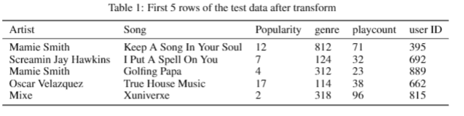
Experiments and results
2. Recommendation
K means cluster: K = 1000
Assume 1000 user
Randomly assign playcount: 1——100
Goal: recommend the top 5 sorted songs to user

Slide 22
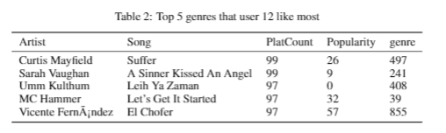
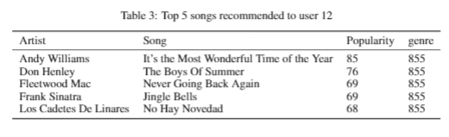
Experiments and results
2. Recommendation

Slide 23
Future directions
In the future, we can to use deep learning algorithm to improve the performance of popularity prediction.
We think it would be interesting to see if we could create a bridge between our prediction model and some sort of revenue prediction model. This could be useful for those music industry to be able to predict of a song will be popular or not, and estimate potential revenues accordingly.

Slide 24
Thanks for listening

